Slide 1
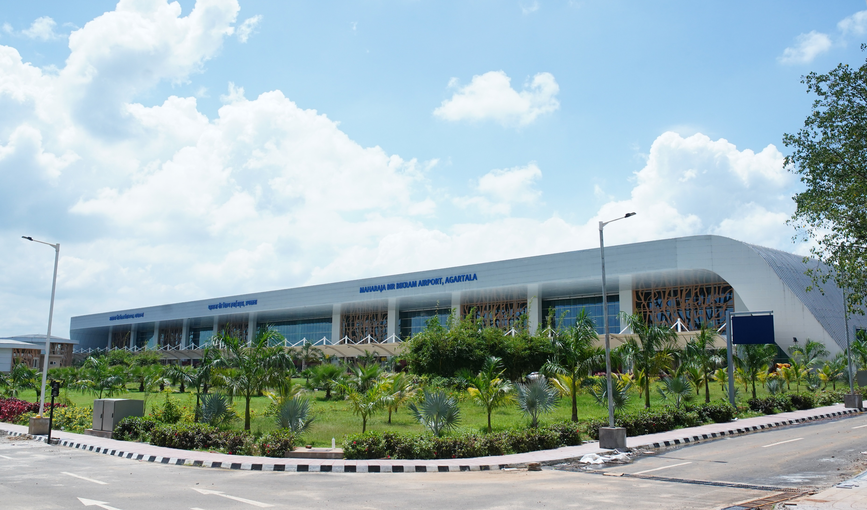
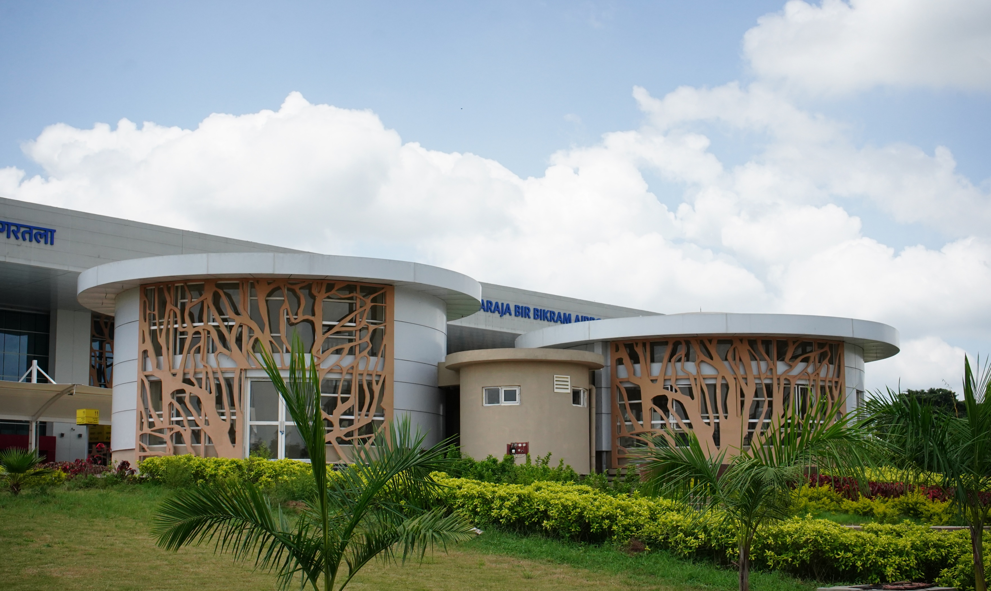
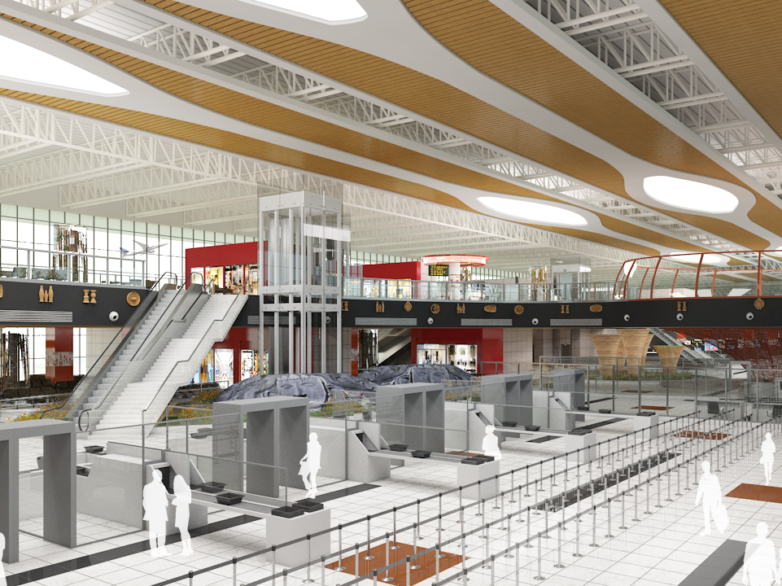
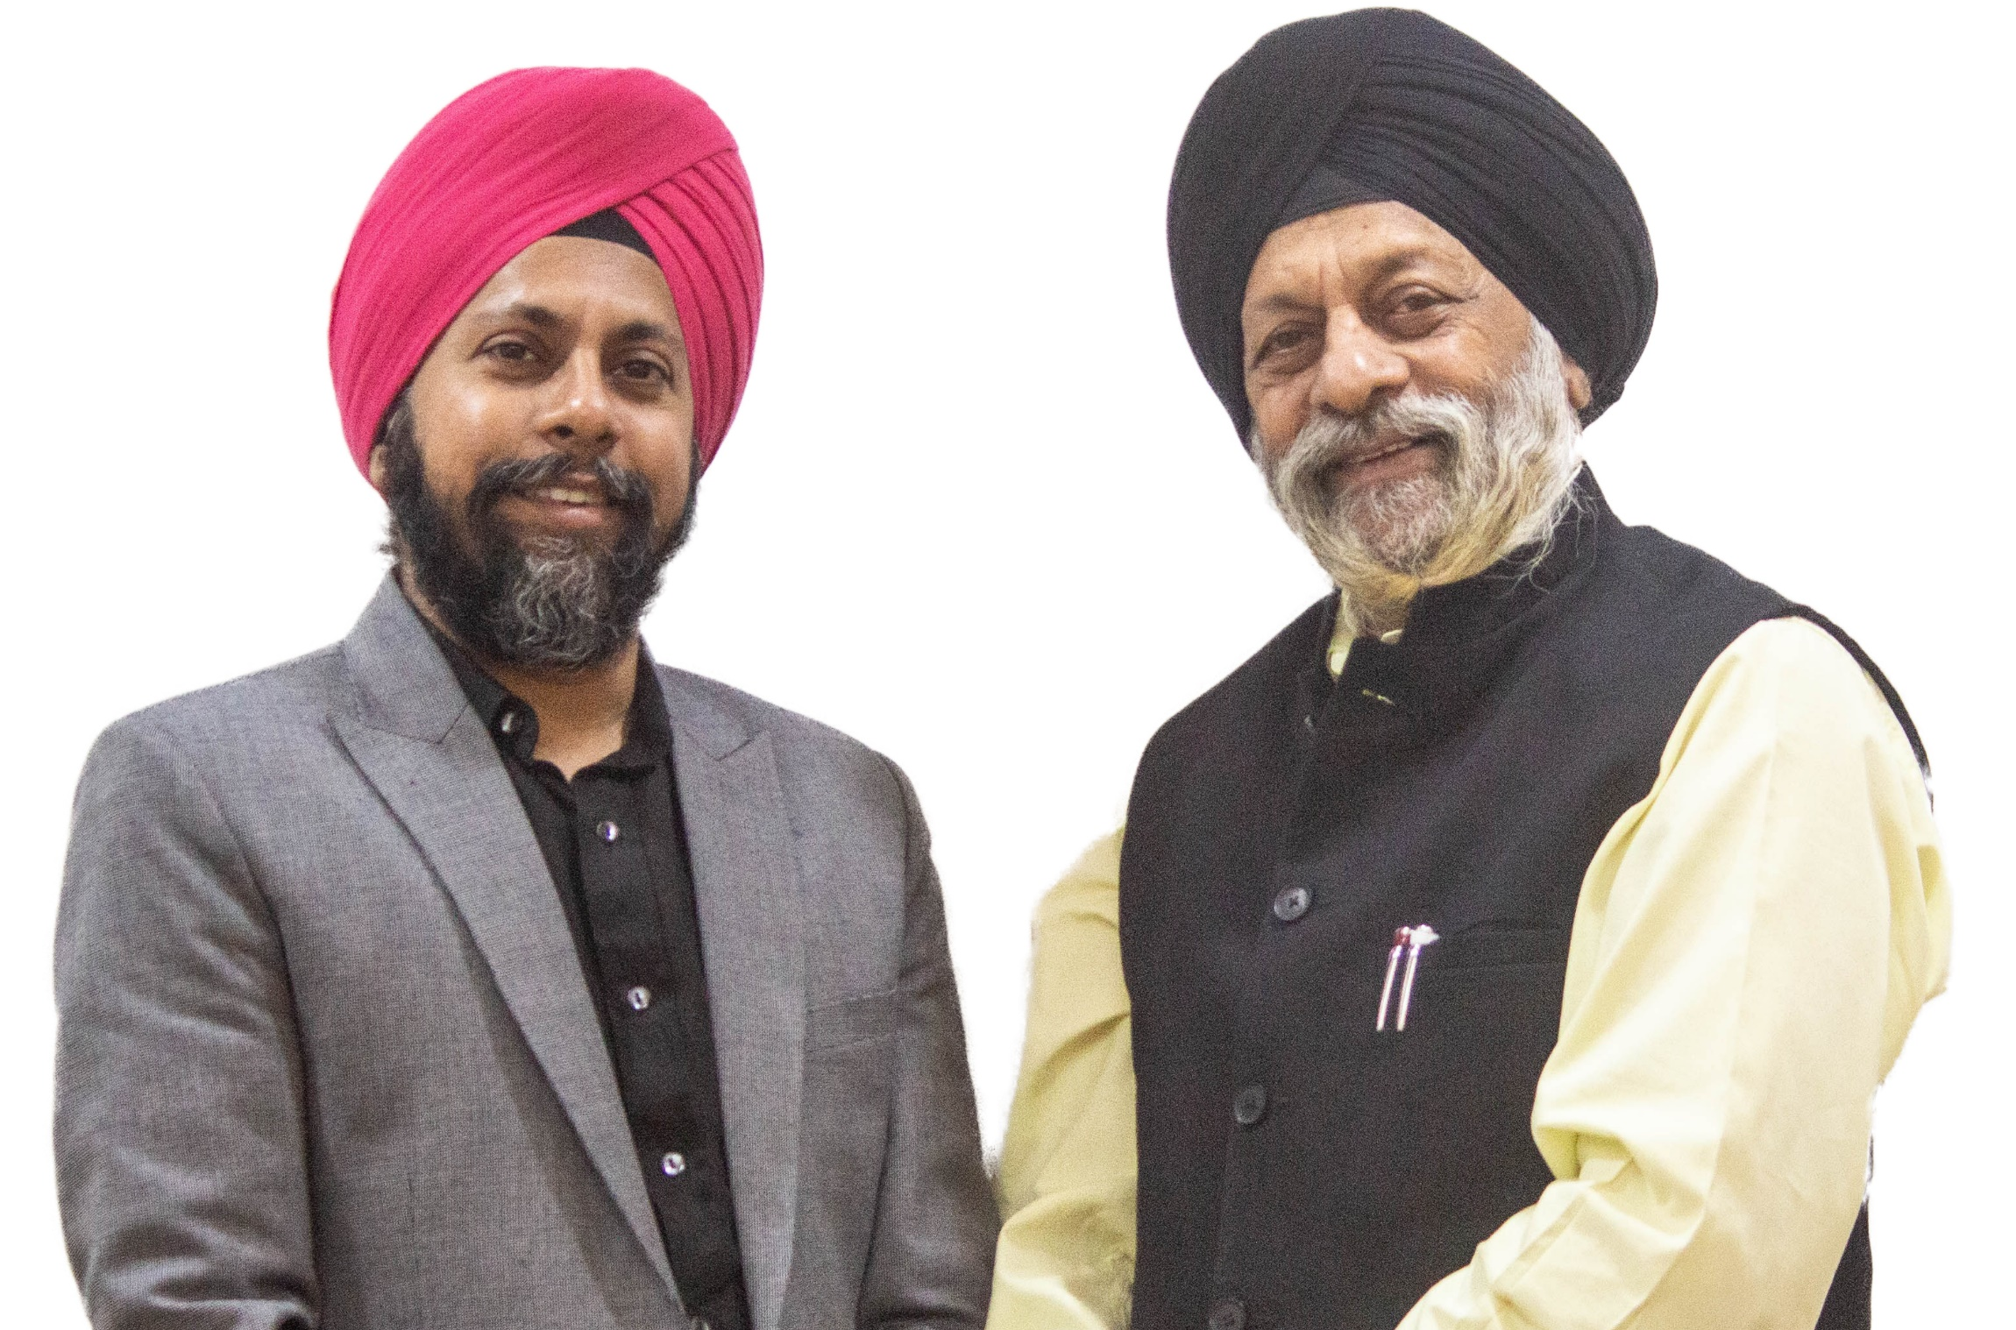

Inauguration of the AGARTALA AIRPORT
Fact File
Name of Project : New Integrated Terminal Building and associated works at Agartala Airport, Tripura
Architectural Firm : Creative Group LLP, Prof. Charanjit Shah, Ar. Gurpreet Shah
Client : Airport Authority of India
Built up Area : 31,500sqm
Cost : 450 Crores
Creative Group LLP is proud to have designed the Integrated Terminal building, Agartala. The existing terminal building at the Bir Bikram Singh Airport was saturated, and there was no further scope for expansion, necessitating the Airports Authority of India (AAI) to construct a new integrated terminal building with an enhanced capacity and modern amenities.
The Agartala Airport derives its vocabulary from the local environment and cultural context. It is a great example of simplicity in architecture. Bamboo is used as a widespread local material in the state for construction whereas tribal artwork and crafts promote cultural tourism.
Transportation terminals are anything but stationary. In their dynamic nature lies our complex challenge to see, understand, and manage flow
—Ar. Gurpreet S. Shah
The Terminal building will be inaugurated today (4th Jan 2022) by the Hon’ Prime Minister Shri Narendra Modiji.
It is a moment of great pride for the firm!
Ar. Gurpreet Singh Shah and Prof. Charanjit Singh Shah Creative Group LLP

Slide 2



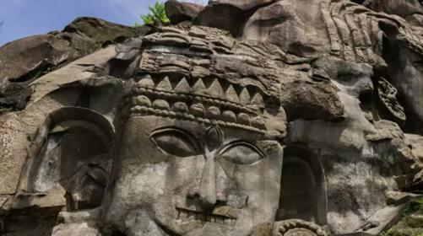
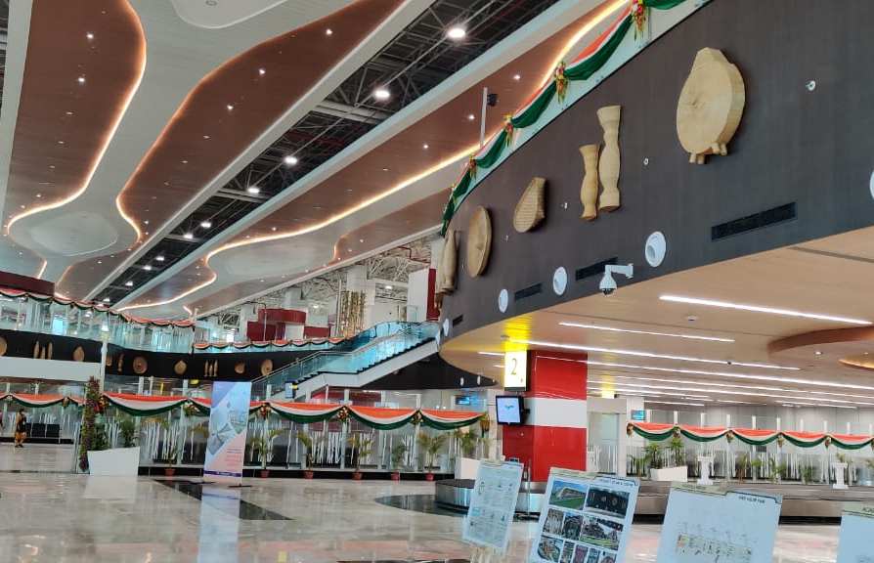
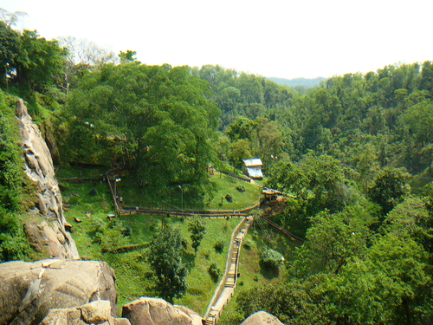
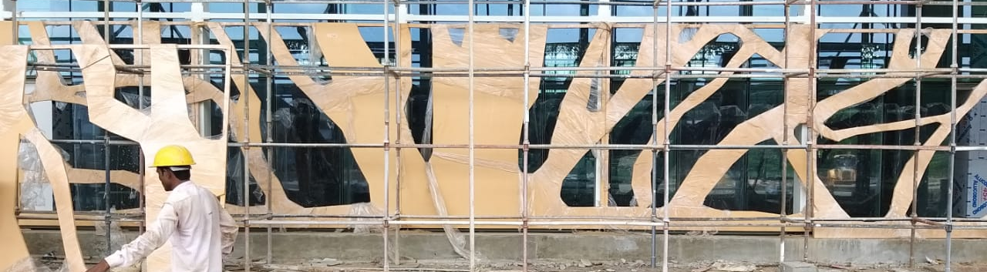
S
implistic Dynamism in ustainable Architecture
The new modern Integrated Terminal Building at Agartala Airport is designed keeping local architecture, art and heritage in mind. The design manifests the sweeping roof profile that envelops the entire terminal spanning across 30,000 Sqm and procures its form from the hilly terrain of the state of Tripura.
Culture of Agartala

Slide 3
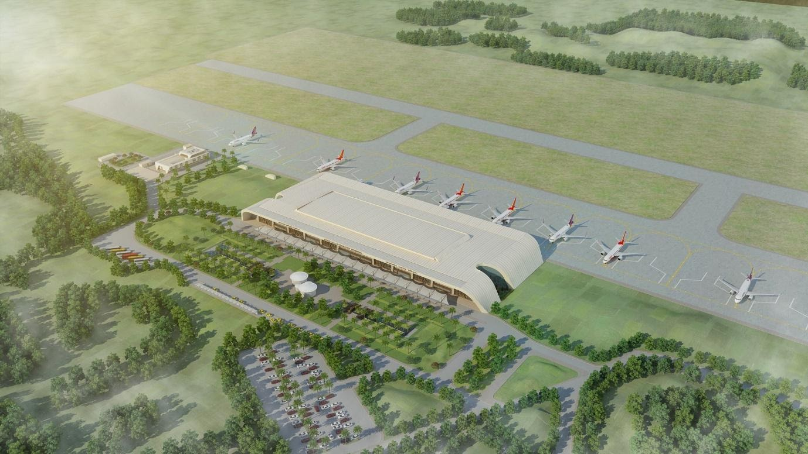
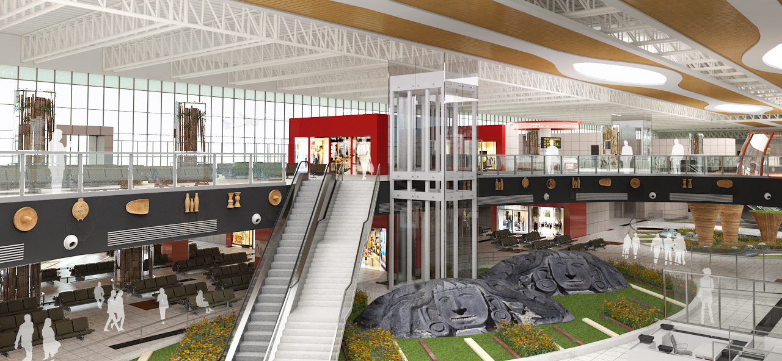
Local Flavor
Terminal Building
Jaalis are an eminent functional design feature, which can be seen in traditional households as well as in royal forts and palaces. It restricts excessive solar radiation and permits optimum daylight to increase internal efficiency. Along with their use, skylights have also been introduced in the design to maximise the natural daylight within the building.
Further, bamboo architecture is represented in the façade of the terminal building by way of a floral GRC Tree Jaali pattern depicting the forests and greens of the region, placed equidistant from each other. Depiction of local motifs in metal cladding helps in creating vibrancy, at the same time informing the users about the art of the state.
Keeping the fluidity of the façade, the plan has also been incorporated with landscape areas inside the building which provide relief space for the passengers. The free flowing form has been further accentuated at arrival and departure areas, with courtyards on either ends of the terminal, and green cover and open spaces allowing light to enter the terminal, lighting it from within with natural glare free light.
Airport infrastructure projects are the gateways to the country, state and city. They purposefully showcase the development of the nation, with an understanding of technology within the built environment and protecting the urban fabric within, while integrating the heritage and architecture of present times
—Prof. Charanjit S. Shah

